Slide 1



E-Tab Tournament! Mondays at 7pm!
Sponsored by
ARROW gaming
No purchases are required

Slide 2

Balloon party night is February 13TH AT 7pm! Come ready to puRCHase and have a great night!!

Slide 3

Join us Tuesday Nights at 7:00 PM for cornhole!!

Slide 4


VFW BREAKFAST!
eVERY SATURDAY
8-11 AM
YOU CAN’T GET A BETTER DEAL THAN THIS!
OPEN TO EVERYONE

Slide 5


Community Breakfast!
8 february 2026 at 11am
All volunteers needed by 9 am

Slide 6
E TABS
TICKETS MUST REDEEMED WITHIN 24 HOURS OF END OF GAMING SESSION
IF TICKET IS NOT REDEEMED PLAYER WILL FORFEIT WINNINGS

Slide 7
WARNING TO MINORS
Persons under the age of 21 are subject to a two hundred dollars if they
1- Enter licensed premises to buy, or have served to them, alcoholic beverages
2-Possess, purchase or attempt to purchase, or get another to purchase alcoholic beverages for them.
Anyone aiding or assisting a person under 21 in purchasing alcoholic beverages is also subject to a fine not to exceed two hundred fifty dollars
3-Misrepresent their age for the purpose of purchasing or obtaining alcoholic beverages
KY. DEPT. OF ALCOHOLIC BEVERAGE CONTROL

Slide 8

100% Smoke free
This includes vapes and chewing tobacco
There are multiple smoking areas outside for your convenience
Thank you!

Slide 9

Nerd Night/Potluck VFW 10281Thursday
^{6:00PM-9:00PM}

Slide 10
Recommendations?
Or suggestions to improve the Environment FOR OUR VETERANS AND POST. PLEASE LET US KNOW

Slide 11
MEMORIAL SERVICES
RON TENNYSON
THURSDAY JANUARY 22ND 2026 1:30PM
VETERAN CEMETARY RADCLIFF KY

Slide 12
MEMBERS IN NEED

Slide 13

NO DOGS OR OTHER PETS ALLOWED
THIS INCLUDES EMOTIONAL SUPPORT, COMPANION AND THERAPY ANIMALS
EXEPT FOR GUIDE DOGS SIGNAL DOGS AND SERVICE ANIMALS WITH CERTIFIED DOCUMENTS IN HAND
WE APPRICIATE YOUR UNDERSTANDING

Slide 14
ORDER OF SERVICE AT THE CANTEEN, IS AS FOLLOWS
1. ALCOHOL
2. FOOD
3. GAMING
4. ALL ETABS MUST BE TURNED IN BY CLOSE OF BUSINESS THE DAY OF PLAY.

Slide 15

TURKEY SHOOT 4 OCTOBER 2025 TO 28 MARCH 2026

Slide 16
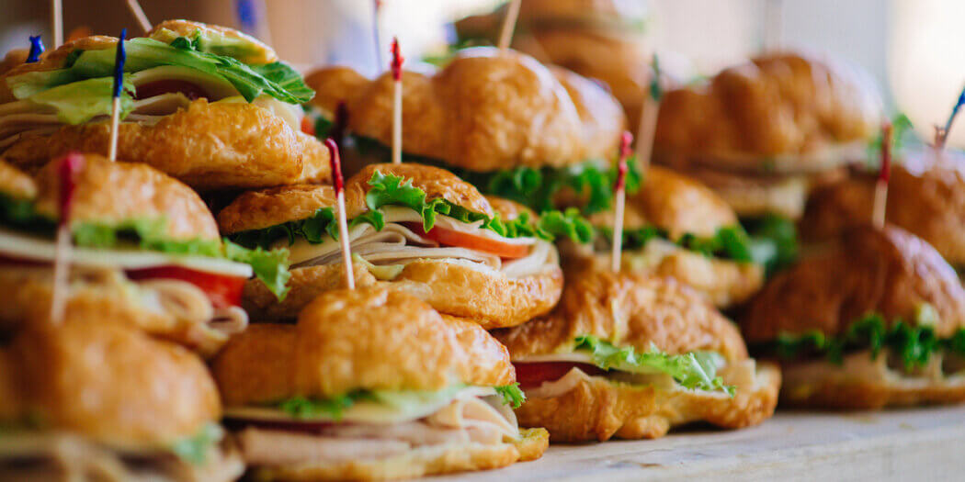
FREE FOOD IN THE CANTEEN AT 5:00PM
JAN 20TH
JAN 21ST
JAN 23RD
JAN 27TH
JAN 28TH
JAN 30TH

Slide 17

AUXILIARY CONFERENCE CHAMPIONSHIP
JANUARY 25TH 2026
OPEN 1HOUR BEFORE GAME

Slide 18
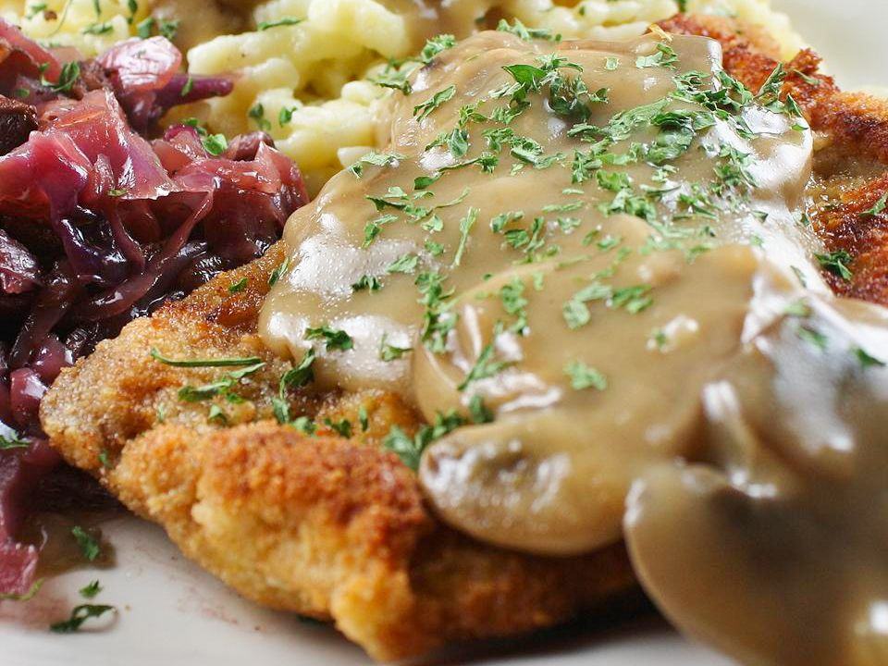
SCHNITZEL FOR LUNCH AND DINNER THURSDAYS
SCHNITZEL DINNER $10.00
DESERT $2.00

