Slide 1



E-Tab Tournament! Mondays at 7pm!
Sponsored by
ARROW gaming
No purchases are required

Slide 2

Balloon party night is 12 june 7pm! Come ready to puRCHase and have a great night!!

Slide 3

Join us Tuesday Nights at 7:00 PM for cornhole!!

Slide 4


VFW BREAKFAST!
eVERY SATURDAY
8-11 AM
YOU CAN’T GET A BETTER DEAL THAN THIS!
OPEN TO EVERYONE

Slide 5


Community Breakfast!
14 June 2026 at 11am
All volunteers needed by 9 am

Slide 6
E TABS
TICKETS MUST REDEEMED WITHIN 24 HOURS OF END OF GAMING SESSION
IF TICKET IS NOT REDEEMED PLAYER WILL FORFEIT WINNINGS

Slide 7
WARNING TO MINORS
Persons under the age of 21 are subject to a two hundred dollars if they
1- Enter licensed premises to buy, or have served to them, alcoholic beverages
2-Possess, purchase or attempt to purchase, or get another to purchase alcoholic beverages for them.
Anyone aiding or assisting a person under 21 in purchasing alcoholic beverages is also subject to a fine not to exceed two hundred fifty dollars
3-Misrepresent their age for the purpose of purchasing or obtaining alcoholic beverages
KY. DEPT. OF ALCOHOLIC BEVERAGE CONTROL

Slide 8

100% Smoke free
This includes vapes and chewing tobacco
There are multiple smoking areas outside for your convenience
Thank you!

Slide 9

Nerd Night/Potluck VFW 10281Thursday
^{6:00PM-9:00PM}

Slide 10
Recommendations?
Or suggestions to improve the Environment FOR OUR VETERANS AND POST. PLEASE LET US KNOW

Slide 11
MEMBERS IN NEED

Slide 12
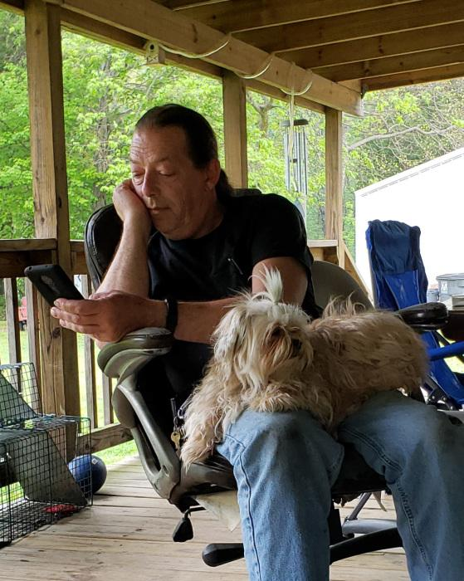
FUNERAL INFORMATION
ROBERT W. DAVIS, AGE 62, OF VINE GROVE
PASSED AWAY WEDNESDAY 13 MAY 2026
GRAVESIDE SERVICES WILL BE HELD AT 12:30PM ON FRIDAY JUNE 5TH AT THE KENTUCKY VETERANS CEMETARY CENTRAL RADCLIFF KY
CELEBRATION OF LIFE WILL BE AT THE VFW
JUNE 13TH FROM 12:00 TO 2:00PM

Slide 13
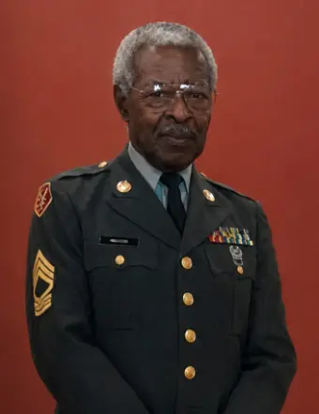
FUNERAL INFORMATION
HERSEY MCCOY WHITE, 81 OF RADCLIFF
DIED SUNDAY MAY 17TH 2026.
FUNERAL WILL BE HELD AT 12:00PM ON TUESDAY MAY 26TH AT RADCLIFF FIRST ASSEMBLY OF GOD.
GRAVESITE SERVICE WILL BE HELD AT THE KENTUCKY VETERANS CEMETARY CENTRAL IN RADCLIFF KY. FOLLOWING THE FUNERAK SERVICE

Slide 14
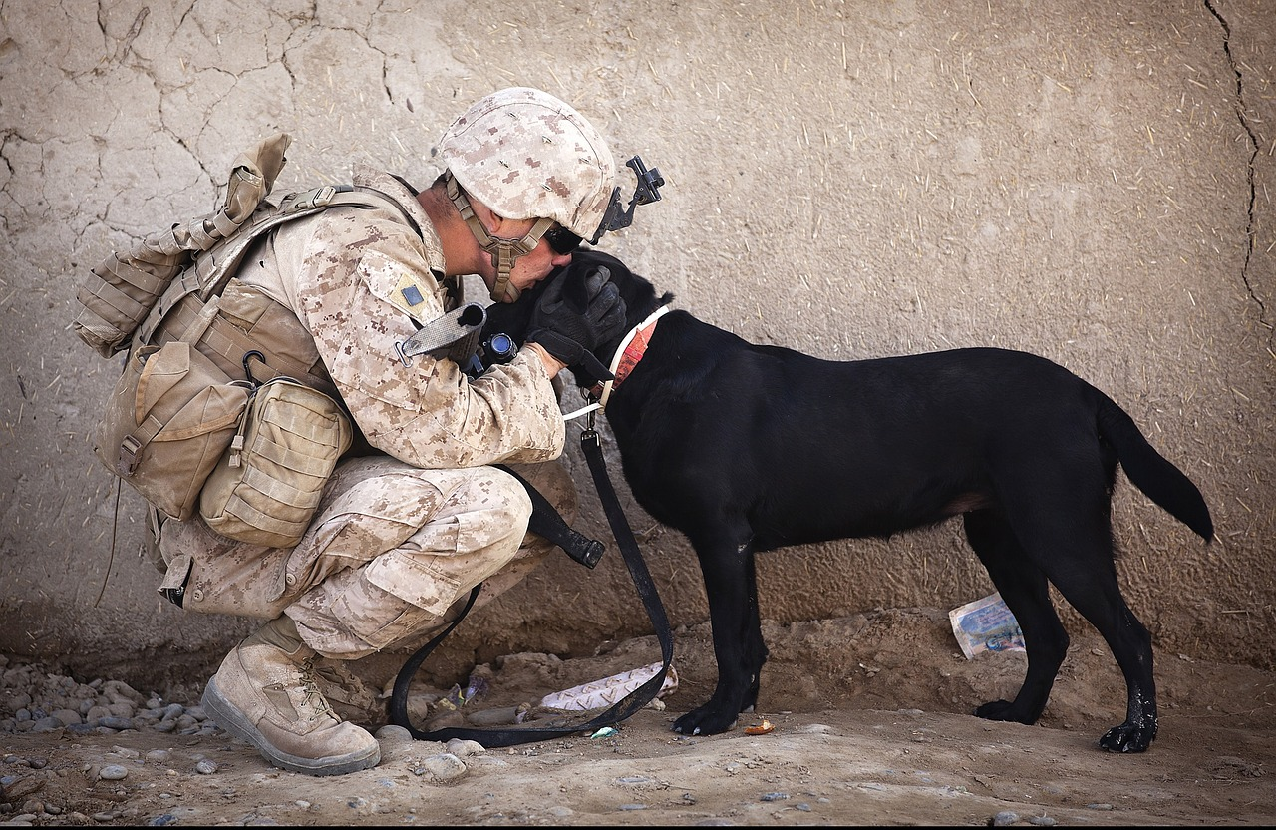
NO DOGS OR OTHER PETS ALLOWED
THIS INCLUDES EMOTIONAL SUPPORT, COMPANION AND THERAPY ANIMALS
EXEPT FOR GUIDE DOGS SIGNAL DOGS AND SERVICE ANIMALS WITH CERTIFIED DOCUMENTS IN HAND
WE APPRICIATE YOUR UNDERSTANDING

Slide 15
ORDER OF SERVICE AT THE CANTEEN, IS AS FOLLOWS
1. ALCOHOL
2. FOOD
3. GAMING
4. ALL ETABS MUST BE TURNED IN BY CLOSE OF BUSINESS THE DAY OF PLAY.

Slide 16
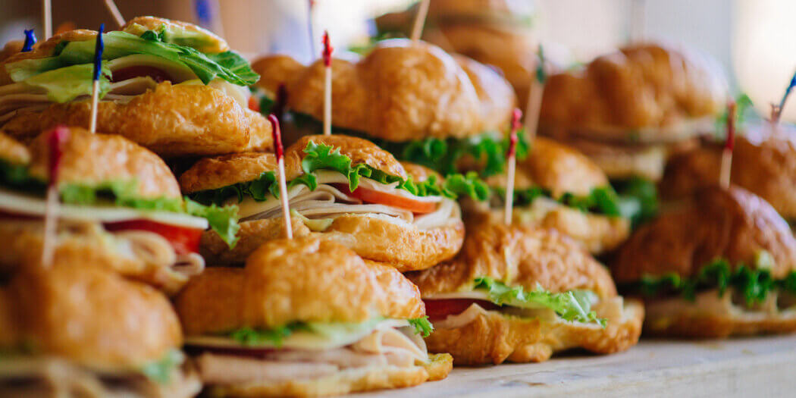
FREE FOOD IN THE CANTEEN AT 5:00PM
MAY 26TH
MAY 27Th
MAY 29TH
JUNE 2ND
JUNE 3RD
JUNE 5TH
JUNE 9TH

Slide 17
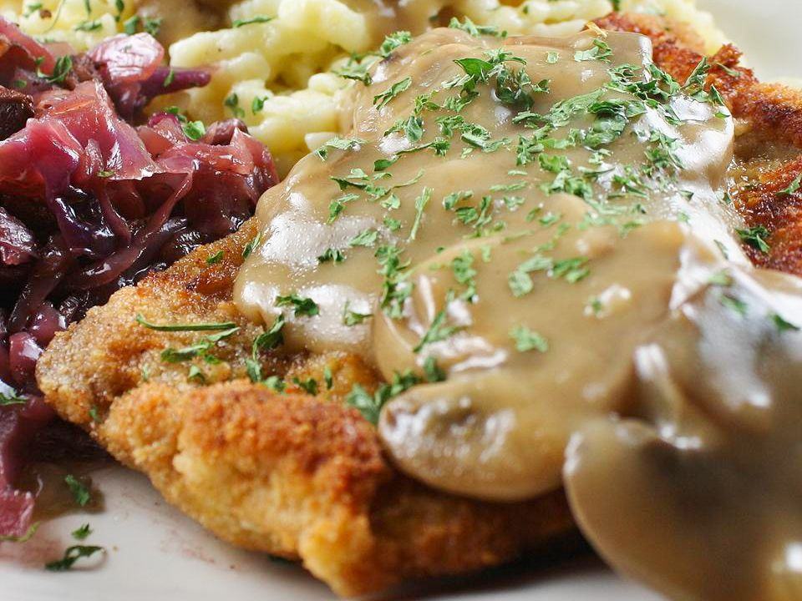
SCHNITZEL FOR LUNCH AND DINNER THURSDAYS
SCHNITZEL LUNCH/DINNER $10.00
DESERT $2.00
LUNCH 11:30 TO 1:00
DINNER 5:00 TO 7:00

Slide 18

KIDS FIDHING DERBY
0830-1500
JUNE 6TH 2026
CAMP CARLSON

Slide 19
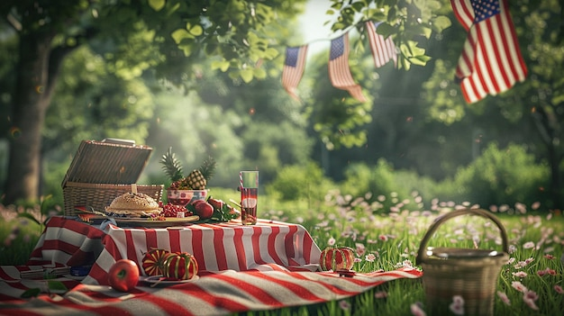
MEMORIAL DAY
FLAG CEREMONY 11:00AM IN THE HALL
AUXILLIARY PICNIC ON THE HILL 12:00PM

