Slide 1



E-Tab Tournament! Mondays at 7pm!
Sponsored by
ARROW gaming
No purchases are required

Slide 2

Balloon party night is 12 june 7pm! Come ready to puRCHase and have a great night!!

Slide 3

Join us Tuesday Nights at 7:00 PM for cornhole!!

Slide 4


VFW BREAKFAST!
eVERY SATURDAY
8-11 AM
YOU CAN’T GET A BETTER DEAL THAN THIS!
OPEN TO EVERYONE

Slide 5


Community Breakfast!
21 June 2026 at 11am
All volunteers needed by 9 am

Slide 6
E TABS
TICKETS MUST REDEEMED AT THE END END OF GAMING SESSION NIGHTLY
IF TICKET IS NOT REDEEMED PLAYER WILL FORFEIT WINNINGS

Slide 7
WARNING TO MINORS
Persons under the age of 21 are subject to a two hundred dollars if they
1- Enter licensed premises to buy, or have served to them, alcoholic beverages
2-Possess, purchase or attempt to purchase, or get another to purchase alcoholic beverages for them.
Anyone aiding or assisting a person under 21 in purchasing alcoholic beverages is also subject to a fine not to exceed two hundred fifty dollars
3-Misrepresent their age for the purpose of purchasing or obtaining alcoholic beverages
KY. DEPT. OF ALCOHOLIC BEVERAGE CONTROL

Slide 8

100% Smoke free
This includes vapes and chewing tobacco
There are multiple smoking areas outside for your convenience
Thank you!

Slide 9

Nerd Night/Potluck VFW 10281Thursday
^{6:00PM-9:00PM}

Slide 10
Recommendations?
Or suggestions to improve the Environment FOR OUR VETERANS AND POST. PLEASE LET US KNOW

Slide 11
MEMBERS IN NEED

Slide 12

JUNETEENTH CLEBRATION
19 JUNE 12:00
ON THE GAZEBO VFW 10281

Slide 13
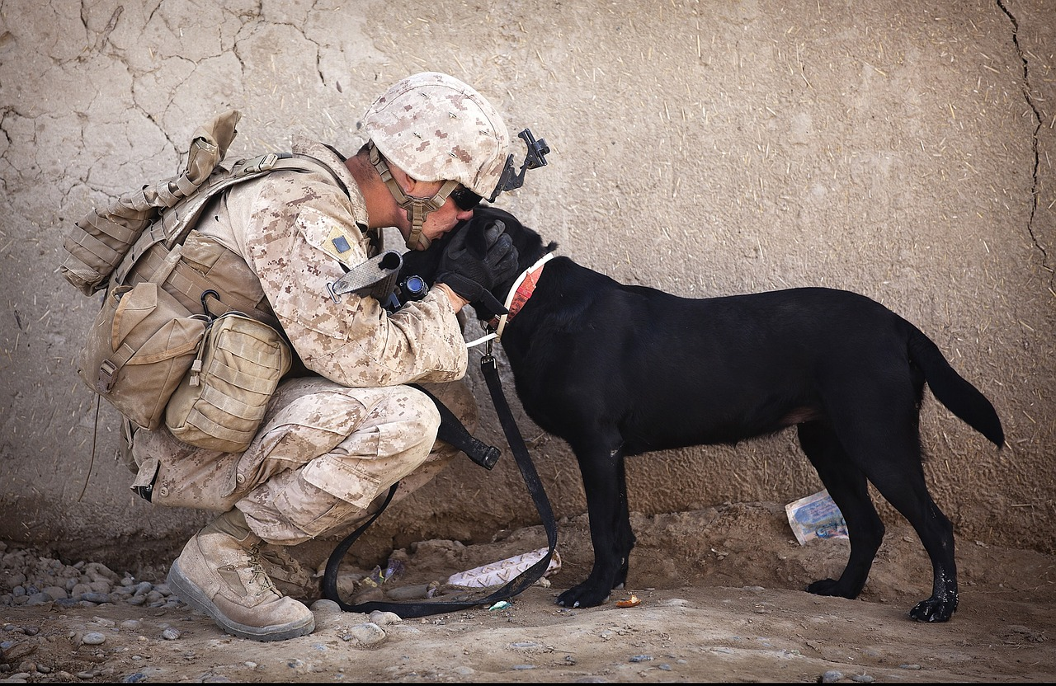
NO DOGS OR OTHER PETS ALLOWED
THIS INCLUDES EMOTIONAL SUPPORT, COMPANION AND THERAPY ANIMALS
EXEPT FOR GUIDE DOGS SIGNAL DOGS AND SERVICE ANIMALS WITH CERTIFIED DOCUMENTS IN HAND
WE APPRICIATE YOUR UNDERSTANDING

Slide 14
ORDER OF SERVICE AT THE CANTEEN, IS AS FOLLOWS
1. ALCOHOL
2. FOOD
3. GAMING
4. ALL ETABS MUST BE TURNED IN BY CLOSE OF BUSINESS THE DAY OF PLAY.

Slide 15
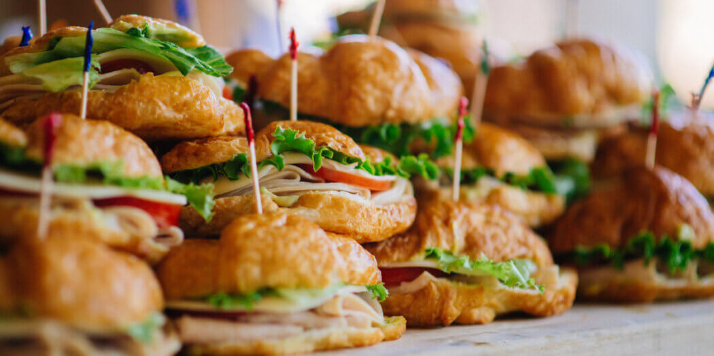
FREE FOOD IN THE CANTEEN AT 5:00PM
JUNE 9TH
JUNE 10TH
JUNE 12TH
JUNE 10TH
JUNE 12TH
JUNE 16TH
JUNE 17TH
JUNE 19TH
JUNE 23RD

Slide 16
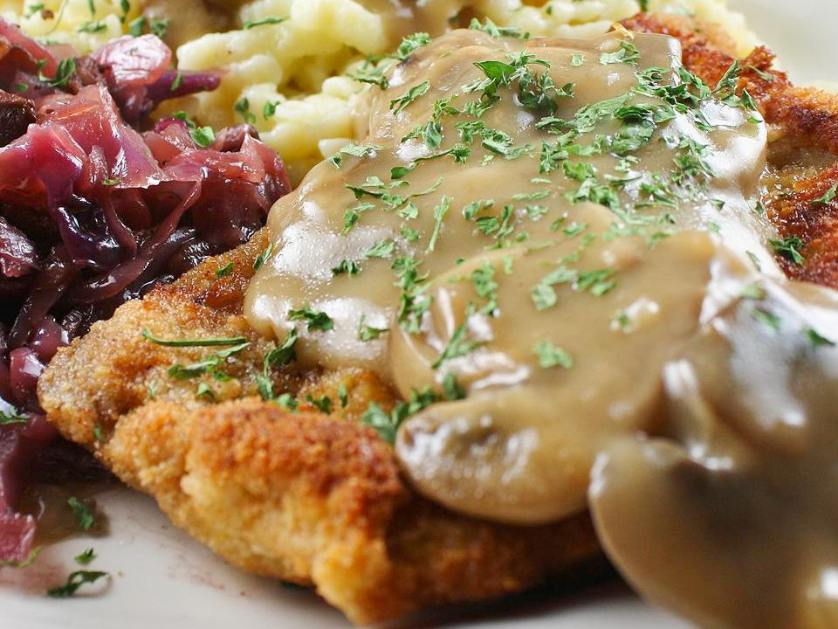
SCHNITZEL FOR LUNCH AND DINNER THURSDAYS
SCHNITZEL LUNCH/DINNER $10.00
DESERT $2.00
LUNCH 11:30 TO 1:00
DINNER 5:00 TO 7:00

