Slide 1



E-Tab Tournament! Mondays at 7pm!
Sponsored by
ARROW gaming
No purchases are required

Slide 2

Balloon party night is April10th 7pm! Come ready to puRCHase and have a great night!!

Slide 3

Join us Tuesday Nights at 7:00 PM for cornhole!!

Slide 4


VFW BREAKFAST!
eVERY SATURDAY
8-11 AM
YOU CAN’T GET A BETTER DEAL THAN THIS!
OPEN TO EVERYONE

Slide 5


Community Breakfast!
12 APRIL 2026 at 11am
All volunteers needed by 9 am

Slide 6
E TABS
TICKETS MUST REDEEMED WITHIN 24 HOURS OF END OF GAMING SESSION
IF TICKET IS NOT REDEEMED PLAYER WILL FORFEIT WINNINGS

Slide 7
WARNING TO MINORS
Persons under the age of 21 are subject to a two hundred dollars if they
1- Enter licensed premises to buy, or have served to them, alcoholic beverages
2-Possess, purchase or attempt to purchase, or get another to purchase alcoholic beverages for them.
Anyone aiding or assisting a person under 21 in purchasing alcoholic beverages is also subject to a fine not to exceed two hundred fifty dollars
3-Misrepresent their age for the purpose of purchasing or obtaining alcoholic beverages
KY. DEPT. OF ALCOHOLIC BEVERAGE CONTROL

Slide 8

100% Smoke free
This includes vapes and chewing tobacco
There are multiple smoking areas outside for your convenience
Thank you!

Slide 9

Nerd Night/Potluck VFW 10281Thursday
^{6:00PM-9:00PM}
^{WE NEED A DUNGEON MASTER}

Slide 10
Recommendations? Or suggestions to improve the Environment FOR OUR VETERANS AND POST. PLEASE LET US KNOW

Slide 11
MEMBERS IN NEED

Slide 12
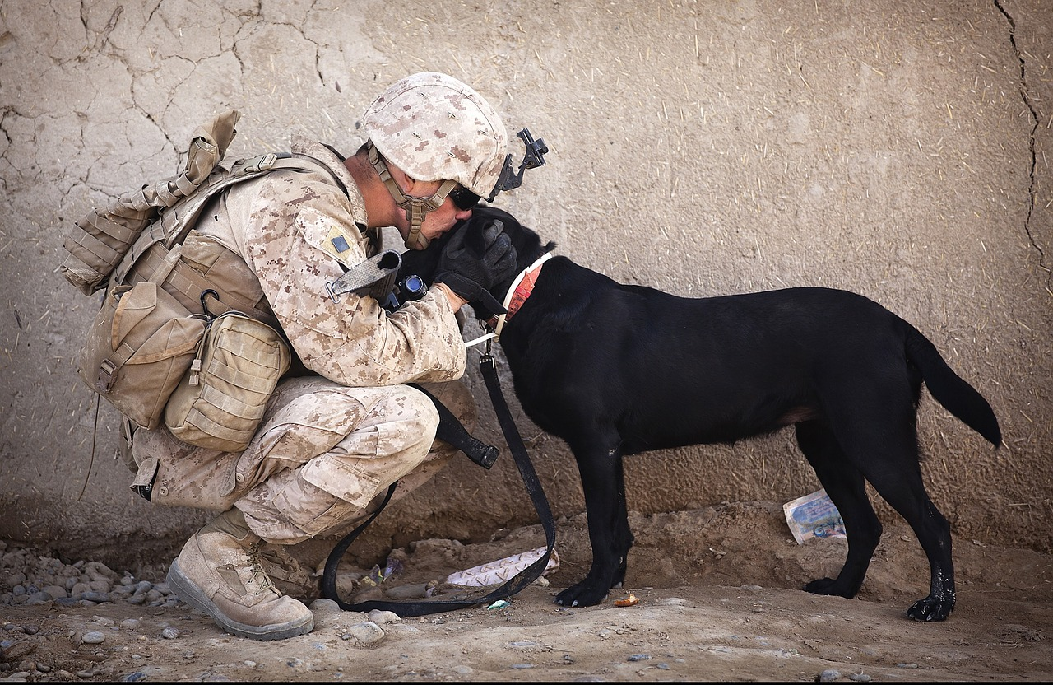
NO DOGS OR OTHER PETS ALLOWED
THIS INCLUDES EMOTIONAL SUPPORT, COMPANION AND THERAPY ANIMALS
EXEPT FOR GUIDE DOGS SIGNAL DOGS AND SERVICE ANIMALS WITH CERTIFIED DOCUMENTS IN HAND
WE APPRICIATE YOUR UNDERSTANDING

Slide 13
ORDER OF SERVICE AT THE CANTEEN, IS AS FOLLOWS
1. ALCOHOL
2. FOOD
3. GAMING
4. ALL ETABS MUST BE TURNED IN BY CLOSE OF BUSINESS THE DAY OF PLAY.

Slide 14
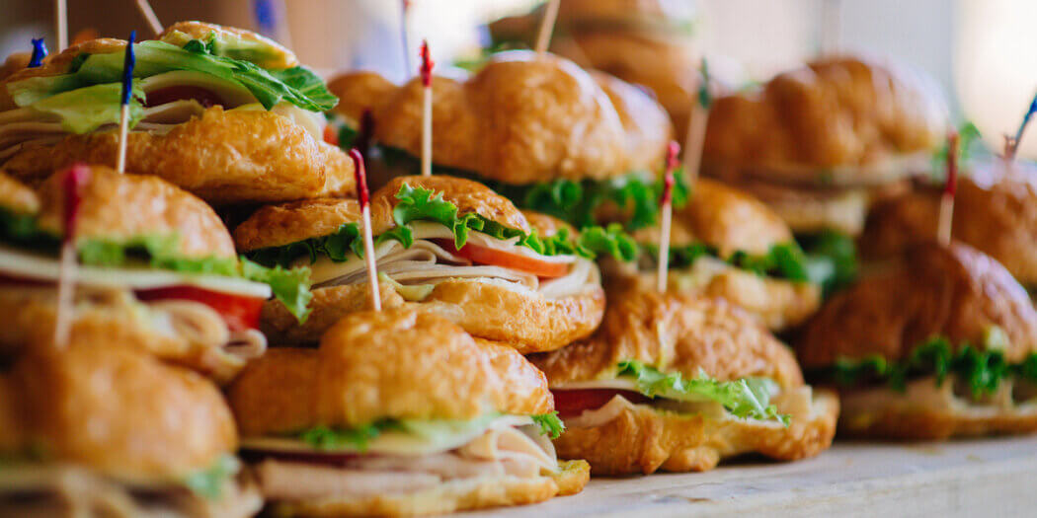
FREE FOOD IN THE CANTEEN AT 5:00PM
APR 10th
APR 14th
APR 15th
APR 17th
APR 21st
APR 22nd
APR 24th
APR 28th
APR 29th

Slide 15
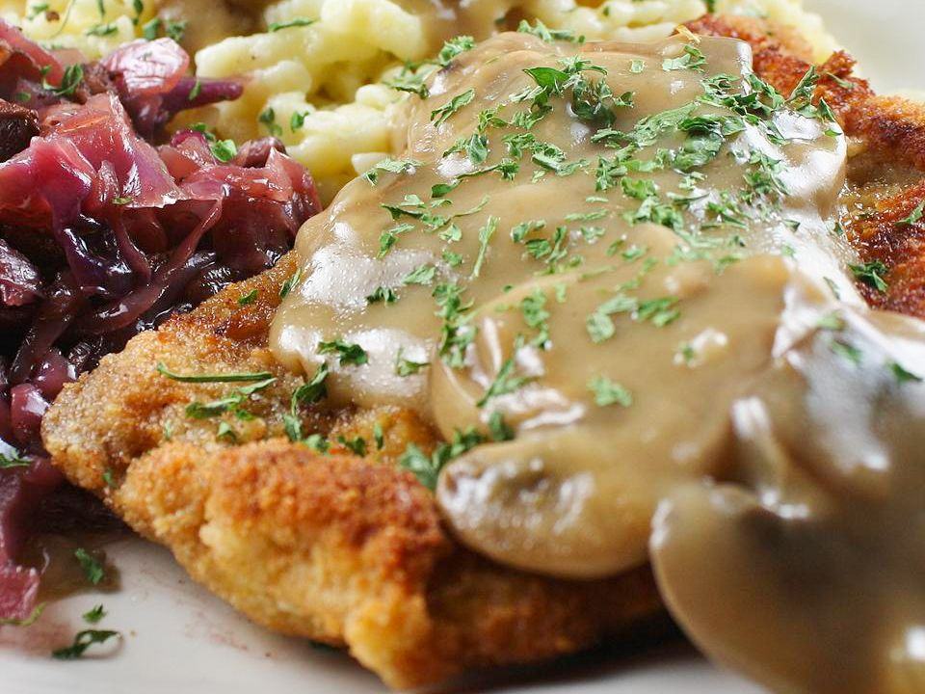
SCHNITZEL FOR LUNCH AND DINNER THURSDAYS
SCHNITZEL DINNER $10.00
DESERT $2.00

Slide 16

RAFFLE APRIL 10TH 2026
BALLOON NIGHT RAFFLE
$5.00 A TICKET SEE THE HOUSE
COMMITTEE OR ASK
BARTENDER. 65 INCH TV.!!!!
PRIZE.
ALL PROCEEDS GO TO THE
EMPLOYEE CHRISTMAS PARTY.
CHARITABLE GAMING 171

